Slide 1

Causal Inference in Genetic Trio Studies – Digital Twin Test
Students: Asaf Gendler and Shalev Shaer
Based on Causal Inference in Genetic Trio Studies by Stephen Bates at all. February 25, 2020
https://arxiv.org/abs/2002.09644

Slide 2
Background
Genome-wide association studies (GWAS) have established the association of thousands of genetic markers with phenotypes of interest.
These studies have the potential to shed light on essential scientific questions and to enable personalized medical care.

Slide 3
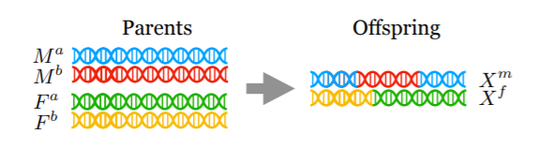
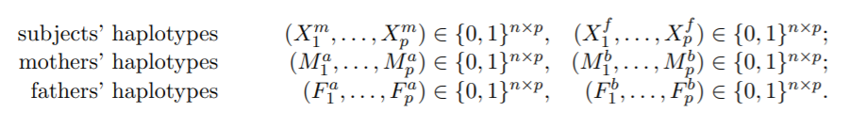
The Trio Data

Slide 4
The Trio Design
Consider the case where the haplotypes of n subjects and their biological parents at p sites are known, denoted as follows:
Denote the matrix of offspring genotypes as , and the set of all ancestral haplotypes as .
Illustration of the recombination process:
It picks from F and M randomly

Slide 5
The Goal
Establishing causality in the Trio design, in a rigorous statistical sense.
Mathematically, we want to test the null hypothesis:

Slide 6
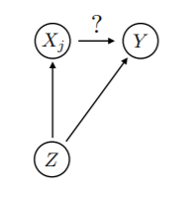
The problem
Any statistical association between a genetic variant and phenotype is detectable, including many irrelevant associations.

Slide 7
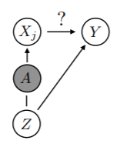
The solution – main theorem
Any valid test of the null hypothesis
is also a valid test of the stronger null hypothesis

Slide 8
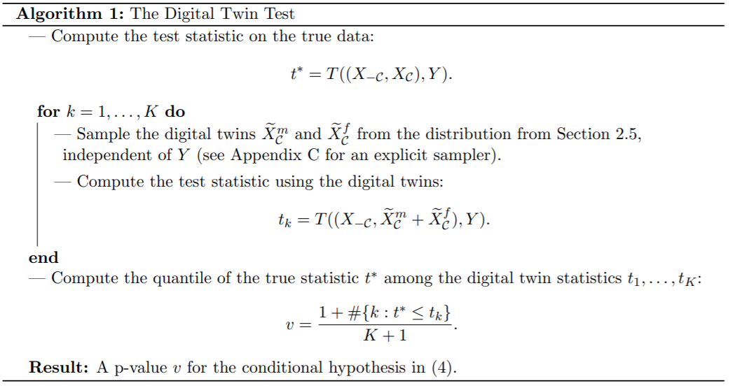
The Way Digital Twin Test (DTT)

Slide 9
Our proposal
We want to examine the option of combining the “twin” samples in the learning process.
In order to do so, we will create a new dataset (for a specific j) as follow:
The Real data will get the label “Real” (1).
The Twin (fake) data will get the label “Fake” (0).
Consider build the data in a “2d+1” method.
Build a classifier that will classify Real / Fake.
Set the T statistic for the as DTT

